Slide 1

Travel Management System
By:-
Anoop Pal (201500108)
Aviral Kumar (201500175)
Guided BY:- Mr. Bhanu Kapoor

Slide 2
Contents
Introduction
Problem Statement
Data Flow Diagram
Module of Projects
Project Screenshot
Future Scope
Conclusion
References

Slide 3
Introduction
The Sum of the phenomena and relationship arising from the travel and stay of non residents.
Travel management system provide reservation facility to there customer.
Maximize travel policy compliance all areas including best fares, allowances and approval.

Slide 4
Problem Statement
The purpose of website is established fact that Internet users are increasing today. Today one of the main purposes of the website is to facilitate the offline customers online because customers cannot spend their precious time in markets trying to find out the best deal.
Our priority will be or customers and their travel requirements.
There will be many users visiting the portal and hence we require a strong and reliable frontend which can withhold the users on our site.
We will be putting an effort to provide the right choice to the people when they plan a holiday and beware them from the false advertising.

Slide 5
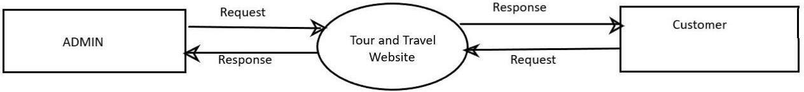
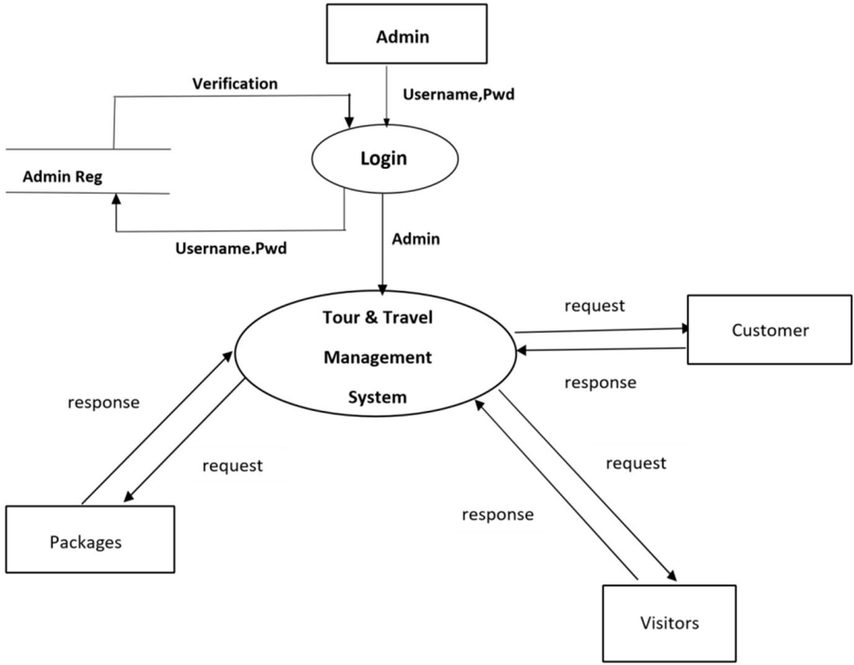
Data Flow Diagram
Context Level Data Flow Diagram
First Level Data Flow Diagram

Slide 6
Module of Project
CUSTOMERS:-
Registration
View Packages
Booking
Give E-Payment
Booking Cancellation
Give Feedback

Slide 7
ADMIN:-
Registration(Login)
Managing User
Manage Tour Packages
Manage Ticket Booking
Manage E- Payment
View Cancellation
View Feedback

Slide 8
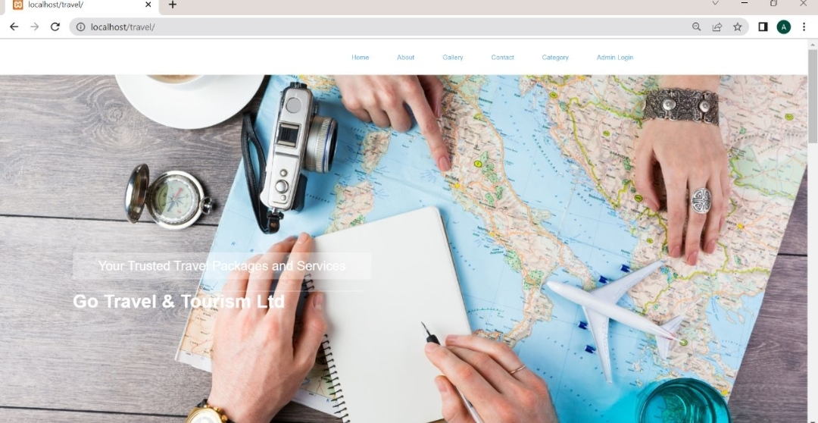
Project Screenshots
Home Page
Description:- Home page of tour and travel management system.

Slide 9
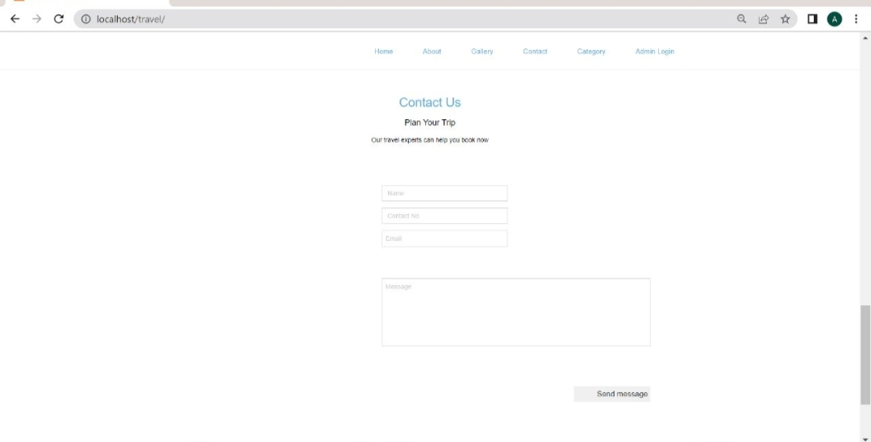
User Registration
Description:- Registration for Trip

Slide 10
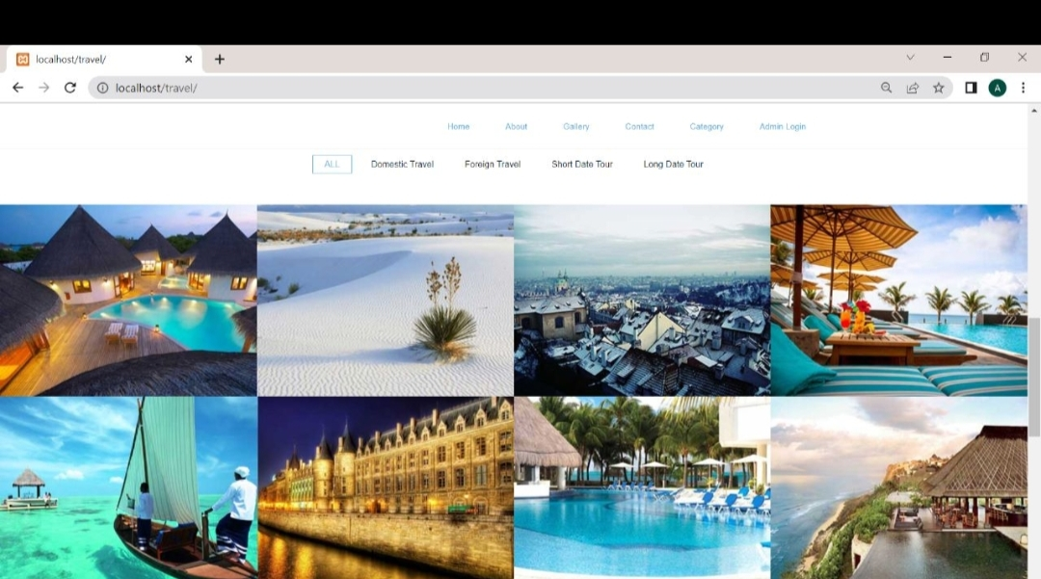
Tour Packages

Slide 11
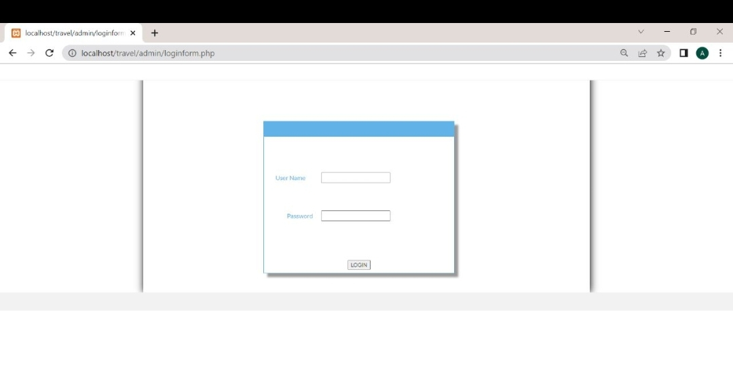
Admin Login

Slide 12
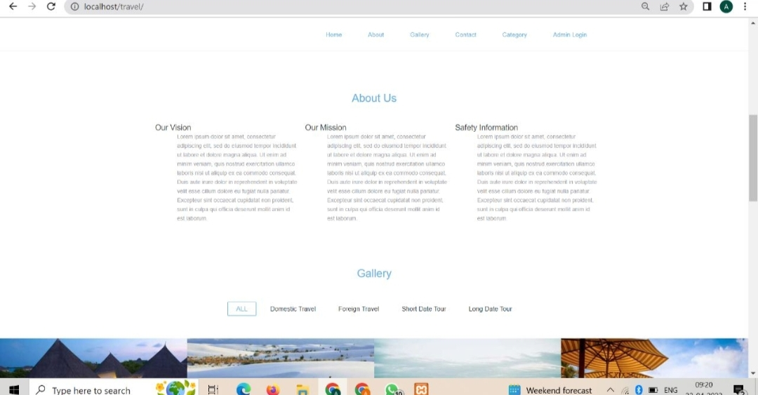
About Us

Slide 13
Future Scope
We will include more functionality as per the user requirements.
We want to improved our Home page, as it is the main thing which attracts all users.
Not a single website is ever consider as complete forever firstly because there is always something new requirements also are growing day by day.

Slide 14
THANK YOU!

